Slide 1
EE 551 Lecture Notes One – Part One
Introduction
Prof. Kevin Ryan

Slide 2
Overview
Programming Languages
Compilers and Interpreters
Portability
Beginning to use Python

Slide 3
Programming Languages
Program; sequence of instructions
Requirement; exact and unambiguous
Examples (of high-level languages); Python, C++, Java, Javascript, Ruby, Perl, BASIC, and others
Syntax; form
Semantics; meaning
Coding;
Process of writing an algorithm in a programming language
We will be doing a lot of coding in the course!

Slide 4
Programming Languages (2)
High-level programming language
Designed to be used and understood by humans
Low-level programming language
Machine language
Understood by computer hardware
Instructions represented by “ones” and “zeroes”
Why? Computer hardware is designed to be “binary”
Two states; ON (or “High”) and LOW (of “Off”)
Conclusion; We require a translation between a high-level language and machine language

Slide 5
Compiler vs. Interpreter
High-level language can either be;
Compiled or Interpreted
Compiler
Converts high-level language into machine code
This conversion is done before program runs
Result; code runs faster
Interpreter
Converts each high-level program statement into machine code
One-by-one during program run

Slide 6
Compiler vs. Interpreter (2)
Compiler
Complete program code is translated into machine code (before program execution)
Result; execution time is less
Machine language is stored
An .exe file is created before program run
Once program is compiled, it may be executed again without need for compiler or source code
Best suited for a production environment
Example; specific code imbedded into a device

Slide 7
Compiler vs. Interpreter (3)
Interpreter
Source program executed line-by-line during execution
Result; increase in execution time
Machine language is not stored
Best suited for the program and development environment
Easier to use
Programs can be developed and run interactively
Python uses an interpreter

Slide 8
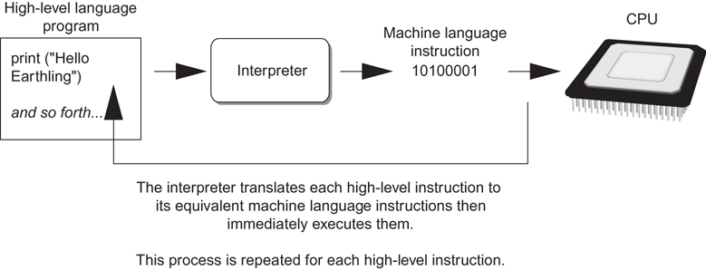
Compilers and Interpreters (3 of 3)

Slide 9
Important Observation; Portability
Translation process provide portability
Exact same program can be executed on different machines
Different CPUs have different machine languages
Machine language on my PC is (most likely) different than machine language on my tablet
Same high-level program can run on my PC and tablet if;
Each has the correct compiler (or interpreter)

Slide 10
The Python Programming Language
Python
Example of a “scripting” (or agile) language
Very flexible; easy experimentation
Widely used in many fields
Business, finance, data analytics
Engineering
One very interesting example; programmable networks (5G)
And many (many) other fields

Slide 11
Using Python
Python must be installed and configured prior to use
One of the items installed is the Python interpreter
Python interpreter can be used in two modes:
Interactive mode: enter statements on keyboard
Script mode: save statements in Python script

Slide 12
Interactive Mode
When you start Python in interactive mode, you will see a prompt
Indicates the interpreter is waiting for a Python statement to be typed
Prompt reappears after previous statement is executed
Error message displayed If you incorrectly type a statement
Good way to learn new parts of Python

Slide 13
Writing Python Programs and Running Them in Script Mode
Statements entered in interactive mode are not saved as a program
To have a program use script mode
Save a set of Python statements in a file
The filename should have the .py extension
To run the file, or script, type
python filename
at the operating system command line

Slide 14
IDLE
IDLE (Integrated Development Program): single program that provides tools to write, execute and test a program
Automatically installed when Python language is installed
Runs in interactive mode
Has built-in text editor with features designed to help write Python programs

Slide 15
Summary
Programming Languages
Compilers and Interpreters
Portability
Beginning to use Python

